Slide 1


Green Pace
Security Policy Presentation
Developer: [Merlin Martinez]
CS 405

Slide 2

OVERVIEW: DEFENSE IN DEPTH
The reason why the security is needed and how it will be used to support the defense-in-depth best practices is by providing extra layers for protection so it could have a strong protection in case any risk and vulnerabilities that could happen to a system if it where Attacked.

Slide 3
THREATS MATRIX
Likely: Probable or likely to happen with a low severity
Priority: Probable or likely to happen with a high severity
Low Priority: Unlikely to happen with a low severity
Unlikely: Unlikely to happen but with a high severity
Likely [STD-002-CPP] [STD-007-CPP] | Priority [STD-005-CPP] [STD-004-CPP]
Low priority [STD-001-CPP] [STD-009-CPP] | Unlikely [STD-006-CPP] [STD-008-CPP]

Slide 4
10 PRINCIPLES
1 Validate Input Data STD-004-CPP, STD-001-CPP
2 Heed Compiler Warnings STD-001-CPP, STD-010-CPP
3 Architect and Design for Security Policies STD-006-CPP
4 Keep It Simple STD-004-CPP, STD-008-CPP, STD-010-CPP
5 Default Deny STD-009-CPP, STD-005-CPP
6 Adhere to the Principle of Least Privilege STD-009-CPP, STD-005-CPP
7 Sanitize Data Sent to Other Systems STD-004-CPP, STD-010-CPP
8 Practice Defense in Depth STD-005-CPP, STD-002-CPP
9 Use Effective Quality Assurance Techniques STD-003-CPP, STD-005-CPP
10 Adopt a Secure Coding Standard STD-003-CPP, STD-006-CLG

Slide 5
CODING STANDARDS
Rule | Severity | Likelihood | Remediation Cost | Priority | Level
STD-001-CPP | High | likely | High | P9 | 2
STD-003-CPP | High | Likely | Medium | P18 | 1
STD-005-CPP | High | Likely | Medium | P18 | 1
STD-008-CPP | Medium | Unlikely | Medium | P4 | 3
STD-007-CPP | Low | Probable | Medium | P4 | 3
STD-006-CLG | Low | Unlikely | High | P1 | 3
STD-002-CPP | High | Likely | High | P9 | 2
STD-010-CPP | High | Probable | High | P6 | 2
STD-004-CPP | High | Probable | Medium | P12 | 1
STD-009-CPP | High | Probable | High | P6 | 2

Slide 6
ENCRYPTION POLICIES
Encryption at rest | Protect stored data. As well database encryption by using MySQL and having backup data.
Encryption in flight | This means that any data that is moving either outside or in network is being protected. Like for example if data is being share between networks, cloud, hard drive and etc. utilizing secure methods like data leak prevention mechanisms built into cloud services, SSH with expiration date on the link and etc.
Encryption in use | This means that the data that is being, created, edited or in use at the time is being protected, in order to protect this type of data you need to ensure that the data control and protection exists prior to use.
https://jatheon.com/blog/data-at-rest-data-in-motion-data-in-use/#:~:text=Your%20data%20should%20be%20encrypted,are%20sending%20or%20receiving%20data

Slide 7
TRIPLE-A POLICIES
Authentication | By authenticating the user, using the necessary valid credentials, there are many ways to authenticate the users like for example using static passwords, one-time passwords, certifications, biometric, tokens etc., are some ways to use authentication and to ensure the system is not getting hacked into.
Authorization | The authorization shows who has the necessary credentials and privileges. This is really important because it shows who and what kind of access the user has to information this help to lower vulnerabilities this help protect sensible data.
Accounting | This monitor logs users activities like, for example, timestamps, , accessed resources, and data transfer information. This is a good resource because helps in creating a trail in the user activity, and also for the purposes of forensic analysis and investigation.
https://www.strongdm.com/blog/aaa-security

Slide 8
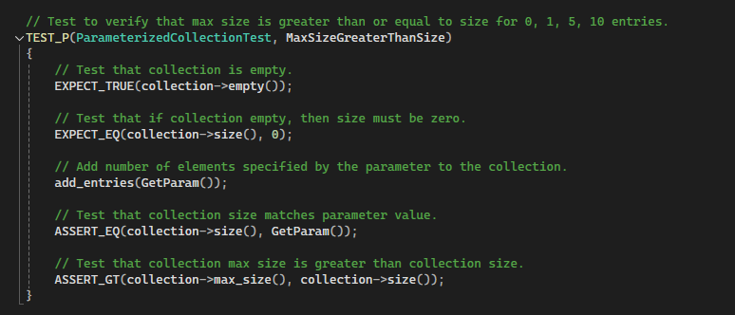
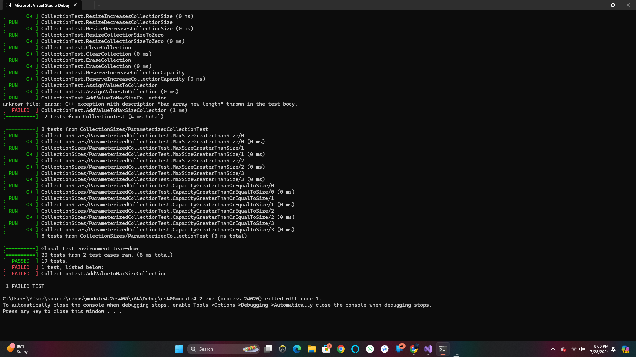
Unit Testing MaxSizeGreaterThanSize

Slide 9
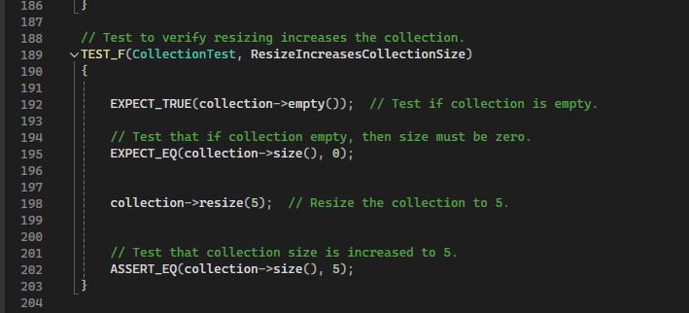
Unit Testing ResizeIncreasesCollectionSize

Slide 10
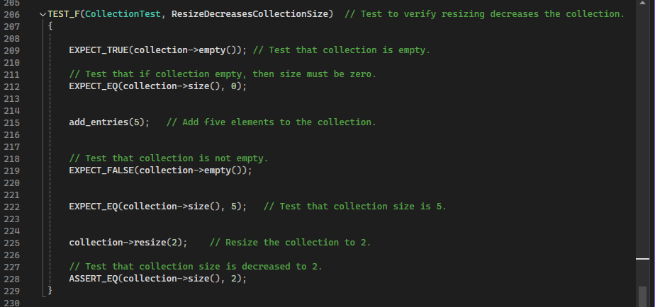
Unit Testing ResizeDecreasesCollectionSize

Slide 11
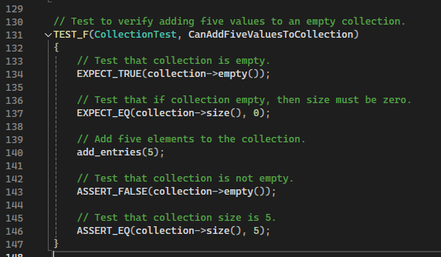

Unit Testing CanAddFiveValuesToCollection

Slide 12

AUTOMATION SUMMARY
The DevSecOps Diagram helps with ensuring you are making good and secure applications, and the flow automation assist with the process. These polices standard must be used during the DevSecOps process.

Slide 13
TOOLS
The DevSecOps pipeline is that the security infrastructure must be thought from the very beginning, and it can't be left for the end.
some of the external tools and where and how they are used in the context of the diagram are the following design stages this means that OWSAP or Security Policy is used to create a secure design, Build stage use secure builds, IDE to compile and run the codes. Verify and testing stages are tools used for ensuring the code works and there is not issues like bugs and etc. they are good Static analysis and unit testing tools

Slide 14
RISKS AND BENEFITS
Security must be thought from the designing phase its something that must be thought from the beginning so it wont impact your application and data.
Risks
Financial loss
customers and public trust loss
Harm on data
Benefits of acting now
Prevent future threats
Prevents big security breaches
Consistent code
Its easier to implement when the security is thought from the beginning

Slide 15
RECOMMENDATIONS
Continuous and automated monitoring of the software dependencies for vulnerabilities and patches to prevent supply chain attacks
Doing annual checks from outside white hat security firm this help another point of view as well help with checking from any risk, threats and vulnerabilities that can appear.

Slide 16
CONCLUSIONS
Good coding practices, defense in depth, constant updates, patches will help to prevent any risks.
Ensuring that security policies are always meet as well regularly reviewed and updated whenever they are needed.

Slide 17
REFERENCES
[Provide APA-style references with links to resources, articles, and videos that you used in your presentation.]

